Slide 1
Friend Zone: Liz Martinez, Greg Douglas, Jose Medina, and June Beaver
October 6, 2021

Slide 2









The World of Connection
Are we ready to connect?
Give us thumb up if you like

Slide 3



























Birds migration into our life circle
Exploration
Analyze
Ready for the tour?
Assimilation
Give us thumb up if you like

Slide 4

Realm of tweeps
# RiceFinTech, # FinTech
Data Exploration

Slide 5
Realm of tweeps
Data Exploration

Slide 6
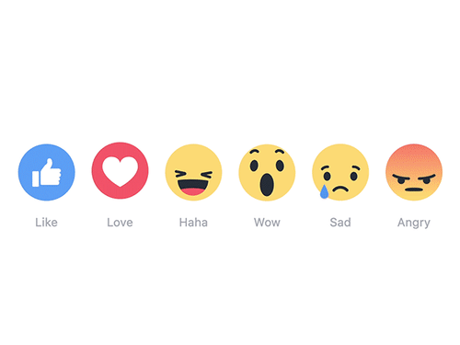
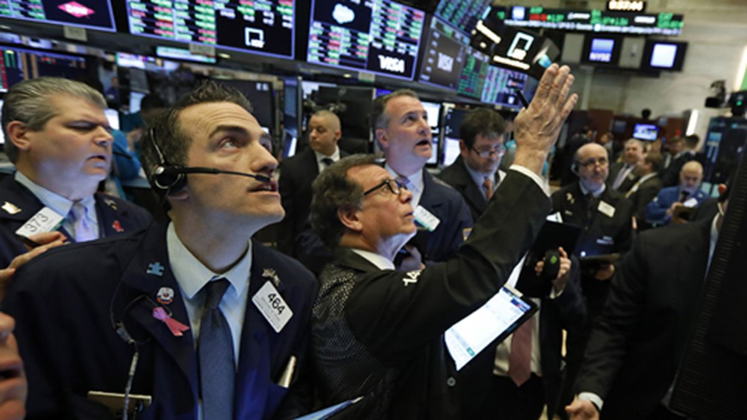
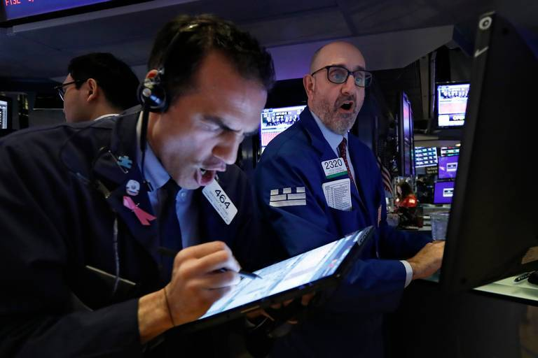
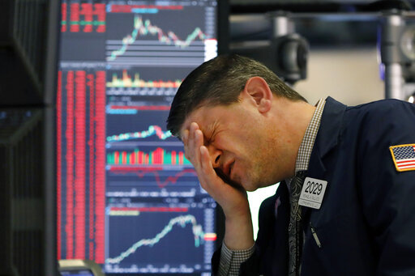
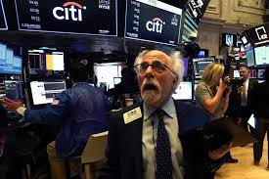
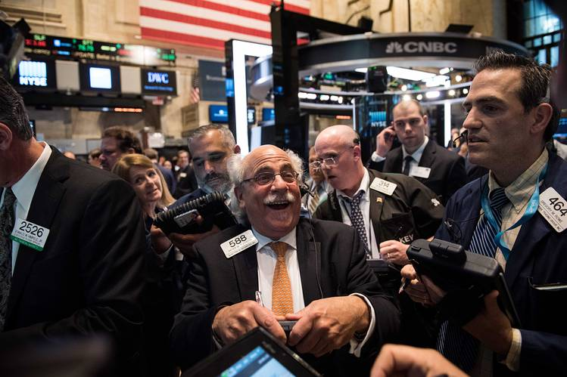
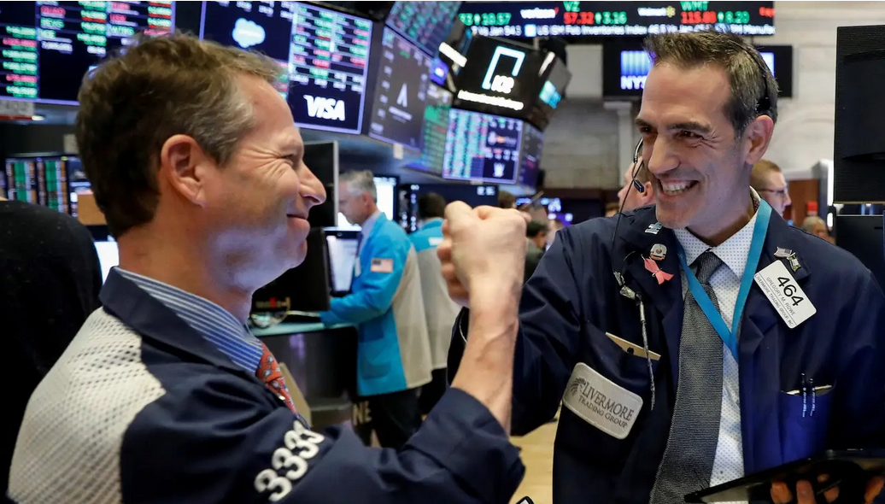
Memoji Feelings
Impact Analysis

Slide 7
Memoji Feelings
Impact Analysis

Slide 8
Happily Ever After (may be not?)
Assimilation

Slide 9
Happily Ever After (may be not?)
Assimilation

